Slide 1
UNIFYING KHMER CULTURAL HERITAGE:
A Semantic Data Model for Cross-Institutional Integration
University of Bologna
Master in Digital Humanities and Digital Knowledge
THESIS DEFENSE
Rubens Fernandes Junior
Supervisor: Prof. Francesca Tomasi
Co-supervisor: Ph.D. Valentina Pasqual
October 2026

Slide 2
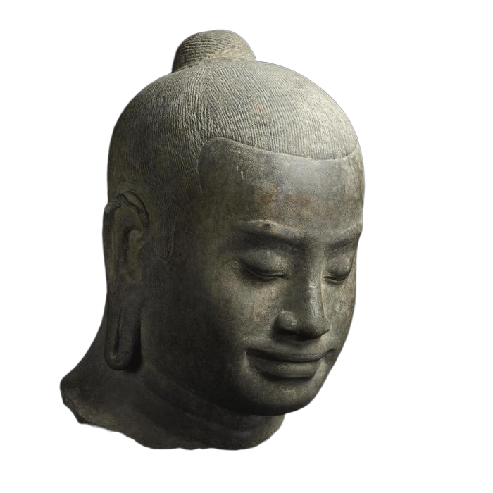
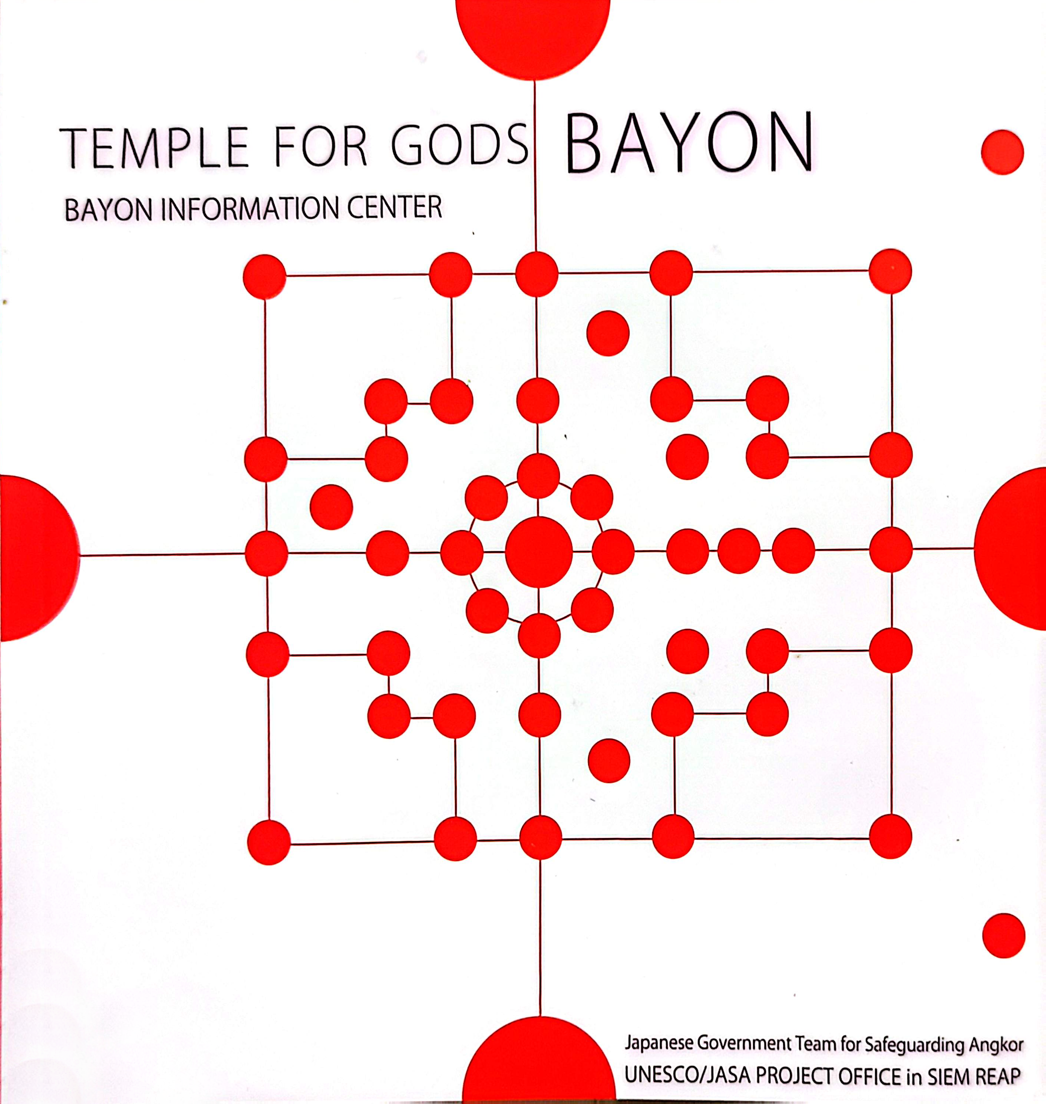
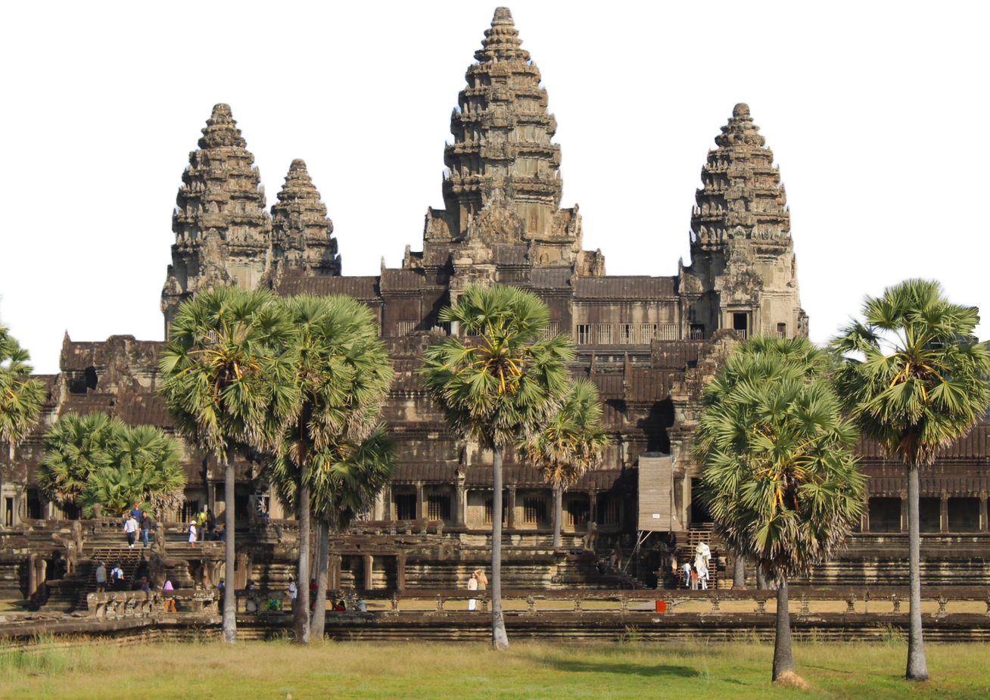
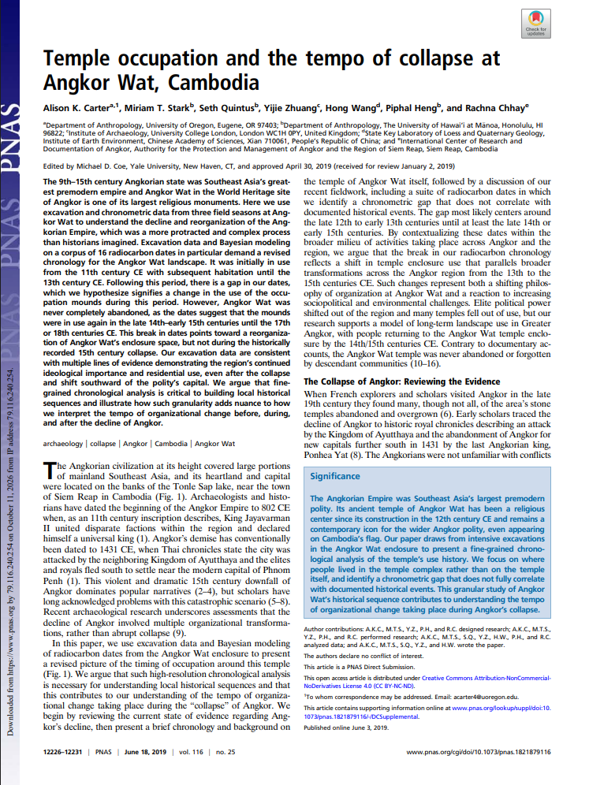
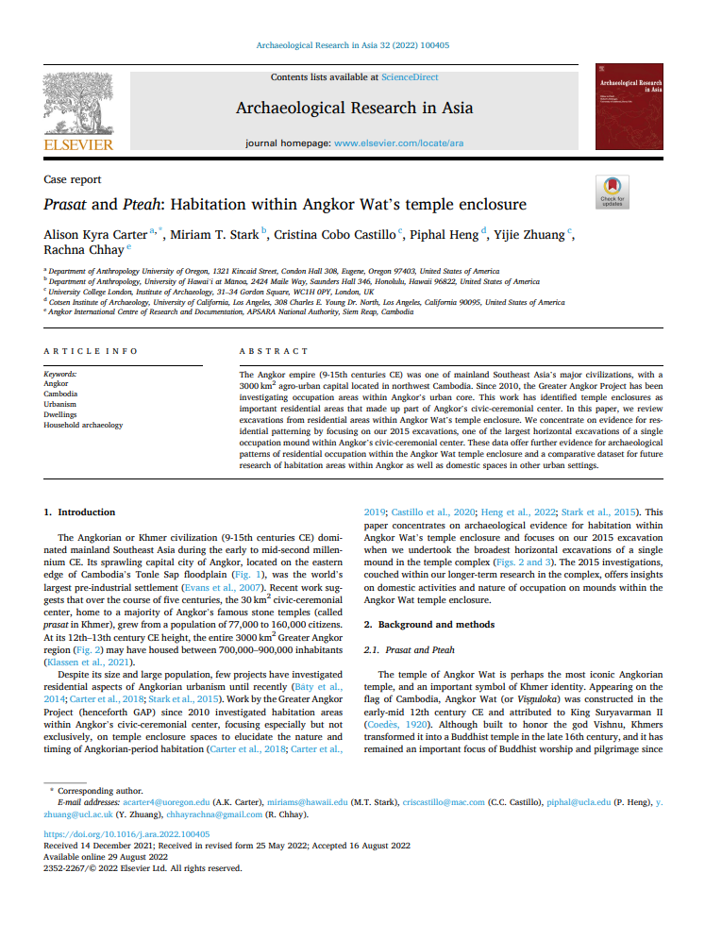
RESEARCH &
CONSERVATION REPORTS
MUSEUM
COLLECTIONS
Problem:
Fragmented heritage
data
SCIENTIFIC
PUBLICATIONS
ARCHAEOLOGICAL & GEOSPATIAL DATA

Slide 3
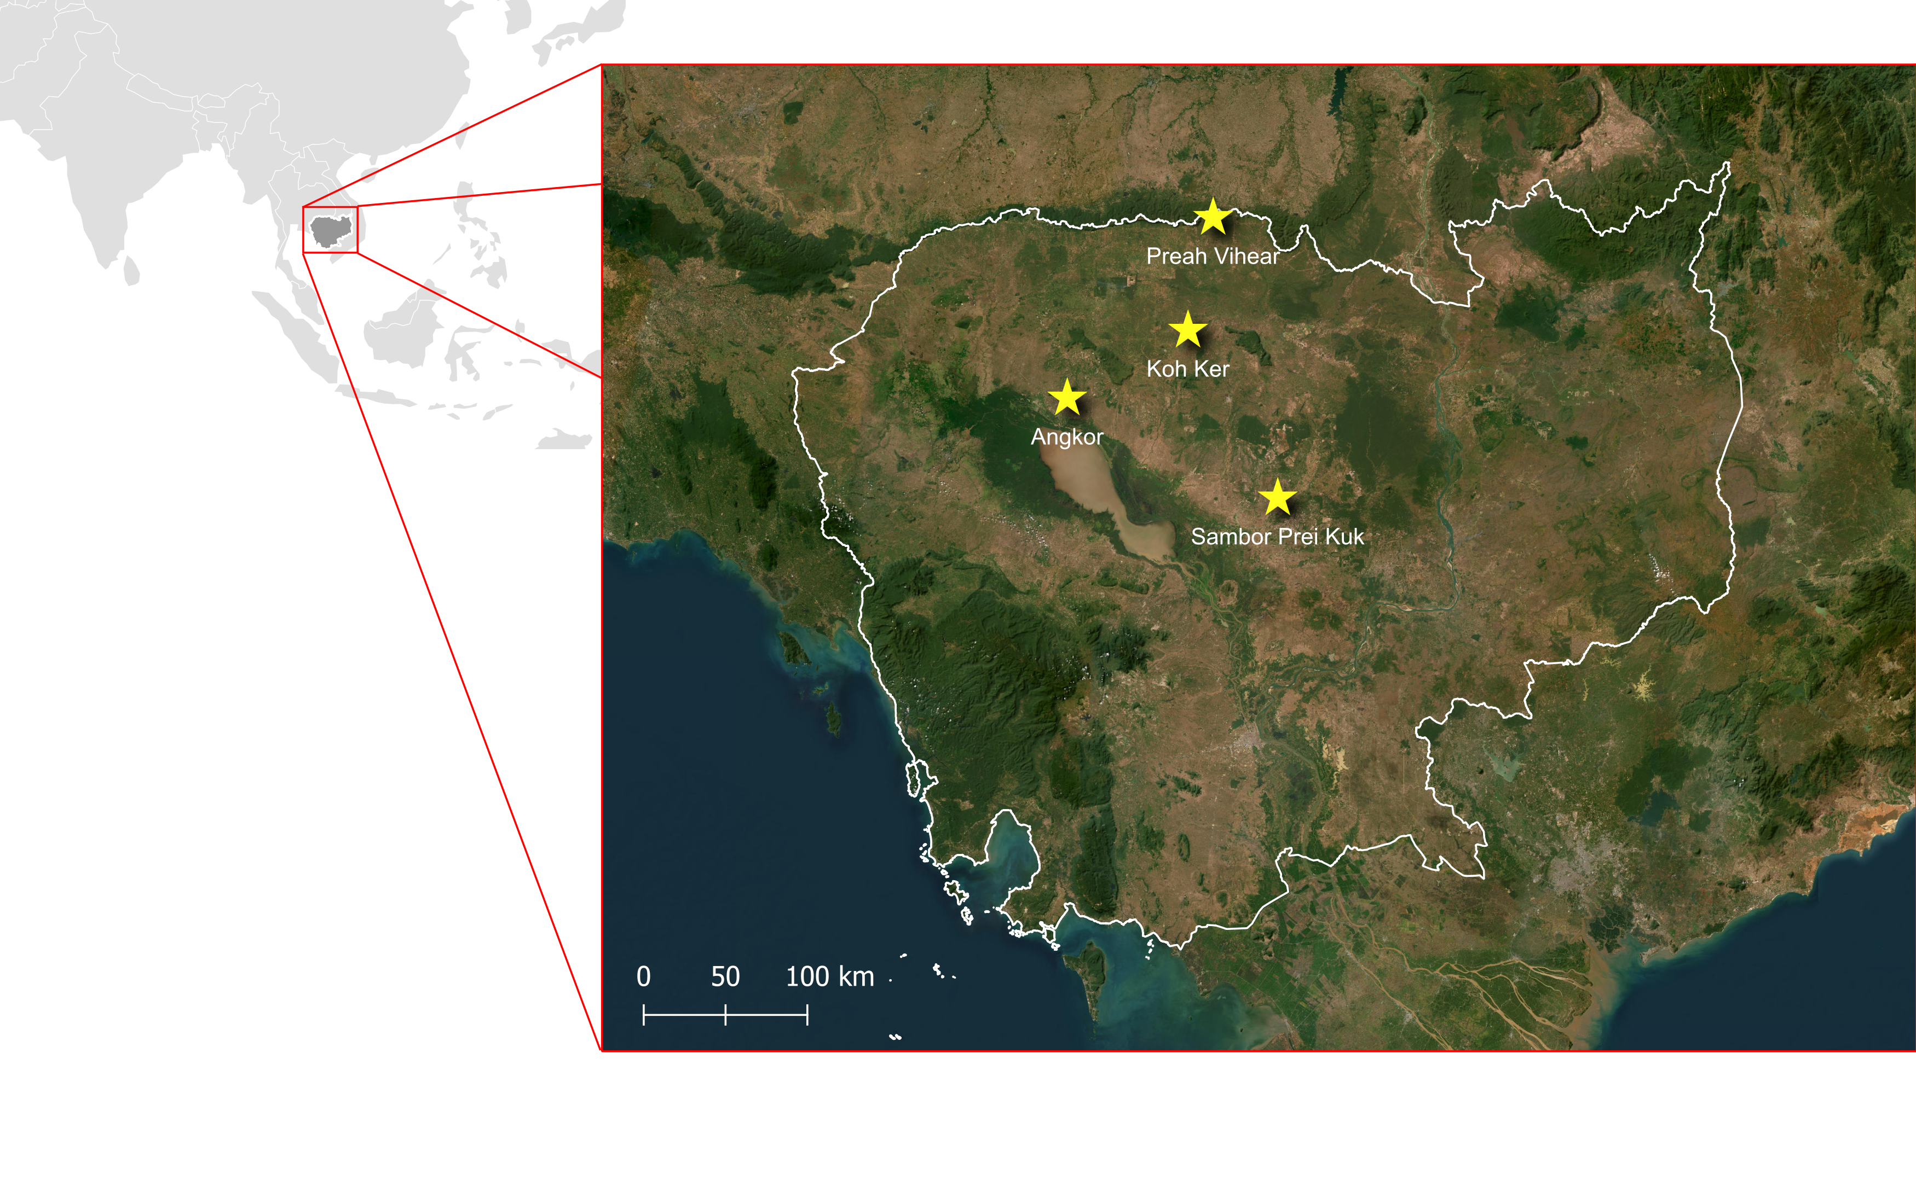
Spatial and temporal scope:
4 Unesco heritage sites
Pre-Angkorian and Angkorian periods (7th to 15th centuries CE)
Source: Data from UNESCO; ESRI Satellite / Created by the author

Slide 4
Research Question & Objectives
How can fragmented data be integrated to provide a comprehensive digital representation of the Khmer cultural heritage domain within the Semantic Web?
O1
Aggregate and harmonize heterogeneous data.
O2
Align metadata practices through established semantic models.
O3
Manage temporal, geographical and terminological variation.
O4
Support relationships and retrieval / visualization methods.
O5
Contextualize the geographical displacement of objects over time.

Slide 5
Methodology
Pipeline:
kh: Namespace
CROSS-INSTITUTIONAL DATASETS
AGGREGATION
&
RECONCILIATION
SEMANTIC MAPPING
ONTOLOGY MODELING
RDF
KNOWLEDGE GRAPH
VALIDATION
&
EVALUATION
MAIN SEMANTIC FRAMEWORK
CIDOC CRM
DATASET COMPOSITION
VALIDATION
Musée Guimet • National Museum of Cambodia • WebOfScience • Scopus • Google Scholar • UNESCO reports • APSARA reports • ESRI Geodata
COMPLEMENTARY MODELS
Protégé Reasoning + SHACL + Competency questions
DCTerms • Bibo • GeoSPARQL • FOAF • Schema • RDFS • SKOS
CONTROLLED VOCABULARY
AAT • Wikidata • GeoNames

Slide 6
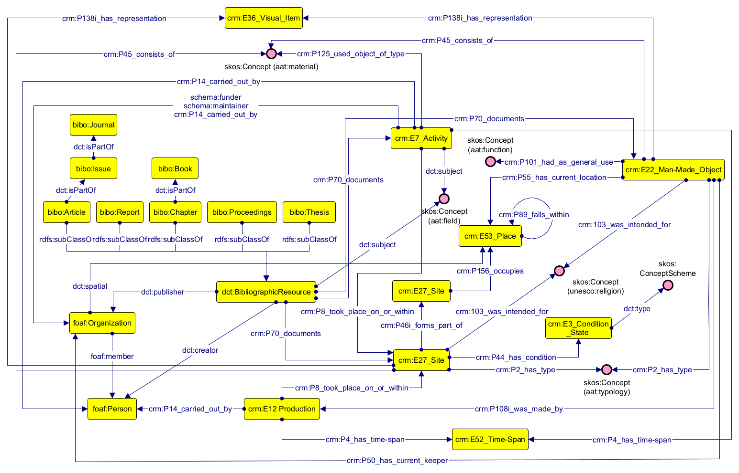
Conceptual Model

Slide 7
Results: Knowledge Graph
— GRAPH SCALE
3,272 named individuals
— FOUR INTERCONNECTED AXES
229 objects (crm:E22_Human-Made Object)
177 sites (crm:E27_Site)
20 conservation projects (crm:E7_Activity)
231 Publications (dct:BibliographicResource)
— CONTEXTUAL NODES
63 places (crm:E53_Place)
392 persons (foaf:person)
230 organizations (foaf:organization)
402 production events (crm:E12_Production)
421 time-spans (crm:E52_Time-Span)
17 materials (skos:Concept)

Slide 8
Results: Competency questions
Internal and cross-domain retrieval
Q1. Which scientific fields produce most publications related to Khmer heritage?
Q2. Which publications are associated with museum objects?
Q3. Which materials were employed in the construction of temples at Sambor Prei Kuk?
Q4. Which countries host institutions that preserve objects dating back to the ninth century?
Q5. Which institutions produce the largest volume of publications concerning Preah Vihear Temple?
Q6. Which projects focus on constructions commissioned during the reign of Jayavarman IV ?

Slide 9
Discussion
Queries validate retrieval
SPARQL execution shows that intended relationships can be retrieved; it does not prove historical truth.
Modeling is interpretative
More than a strict technical implementation, modeling is an epistemic process.
Interoperability ≠ uniformity
The model connects sources while preserving differences in terminology, granularity and interpretation.
Current limitations
Sample corpus and limited source availability
Manual entity reconciliation does not scale easily
Object custody trajectories remain incomplete
No visualization interface implemented or evaluated
Further developments
Expand corpus and institutional coverage
Semi-automated reconciliation workflows
Web interface: maps, timelines, networks and provenance views
Represent competing scholarly interpretations

Slide 10
Conclusion
Technical contribution
A queryable RDF knowledge graph grounded in CIDOC CRM that connects four dimensions of Khmer cultural heritage documentation.
Methodological contribution
Semantic integration as a process that balances structural normalization, granularity, uncertainty, and must be documented beyond technical implementation.
Research contribution
Unifies fragmented Khmer documentation into a semantic framework that enables scholars to navigate across distributed institutional archives and gather connected information.
Thank you • Questions

